Slide 1


Klang Valley HomeRent: Find Your Perfect Room in Klang Valley
Connecting tenants with ideal room rentals in Malaysia’s vibrant Klang Valley
Notes:
1

Slide 2

The Challenge: Navigating Klang Valley’s Rental Market
Fragmented Listings
Dispersed across various platforms, making a comprehensive search difficult and time-consuming.
Lack of Transparency
Inconsistent information, hidden fees, and unreliable landlord communication create distrust.
Inefficient Matching
Difficulty in finding rooms that truly match specific preferences, budget, and lifestyle needs.
Notes:
2

Slide 3




Who Are We Helping?
Students
Seeking affordable, convenient housing
near campuses.
Young Professionals
Finding well-located rooms close to their
workplaces.
Expatriates
Requiring furnished, hassle-free living
arrangements.
Notes:
3

Slide 4




Our Objective:
Simplify Room Rentals
Easy Search
To provide an intuitive platform that aggregates
verified room listings.
Enhance Trust
To build a transparent ecosystem for both tenants
and landlords
Ensure Satisfaction
To make the room rental process a positive and
stress-free experience
Notes:
4

Slide 5

Why Now? The Driving Force
Urban Migration
Klang Valley's population continues to grow, driving demand for housing.
Digital Shift
Increasing reliance on online platforms for everyday needs, including housing
Market Gaps
Existing platforms often lack specific features tailored to room rentals in Malaysia.
Notes:
5

Slide 6

The Klang Valley HomeRent Solution
Frontend Excellence
Fast deployment via Vercel, built with Typescript/JavaScript for a luxury user experience.
Core AI
JamAi Base (Proprietary AI Chat Assistant) providing instantaneous, localized answers in English and Malay.
Backend
Resilient and fast data management using a hybrid database (Neon PostgreSQL & MySQL).
Integration
A reliable Python API ensures flawless synchronization between the frontend and powerful backend.
Notes:
6

Slide 7




Key Features:
What We Offer
Advanced Search Filters
Location, budget, amenities, flatmates.
Verified Listings
Ensure authenticity with verified landlords and property details, reducing fraudulent listings.
Tenant-Landlord Chat
Direct communication, transparent process.
Notes:
7

Slide 8
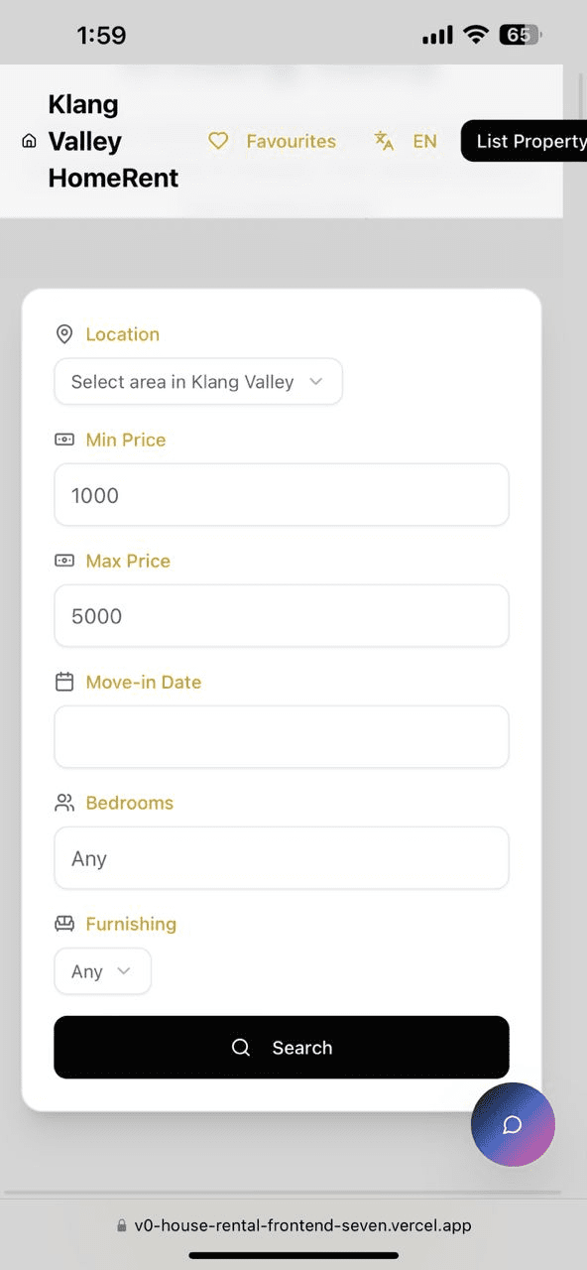
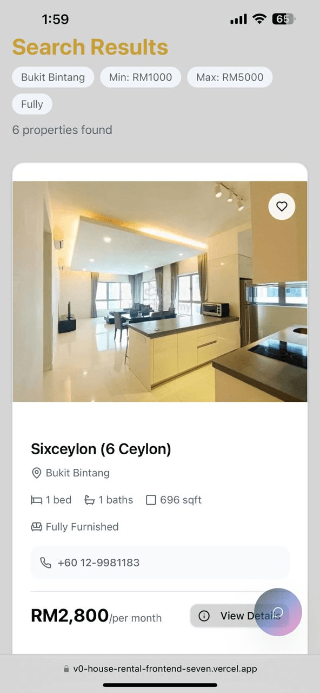
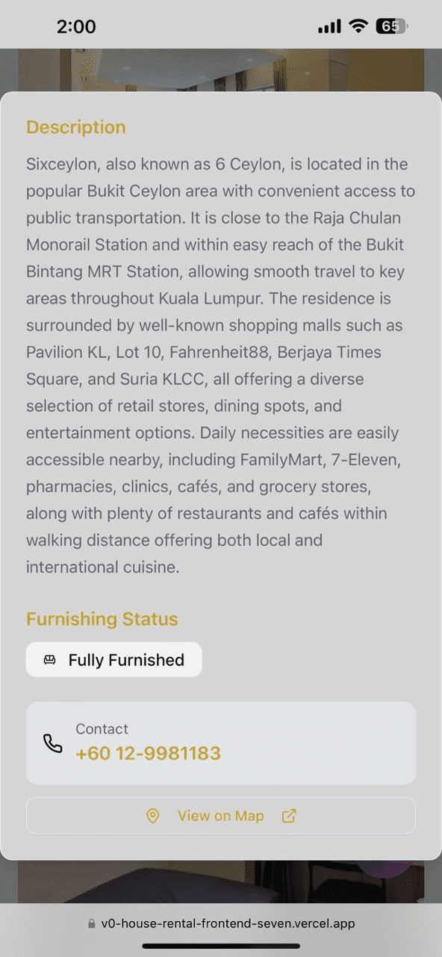
Your Journey with Klang Valley HomeRent
01
Search & Filter
02
View & Connect
03
Book & Secure
Notes:
8

Slide 9

Our Unique Value Proposition
Local Expertise
Deep understanding of Klang Valley.
Tenant-Centric
Prioritising your needs and safety.
Seamless Experience
Technology-driven efficiency.
Notes:
9

Slide 10



Innovation & Differentiation
AI-Powered Matching
Advanced algorithms for perfect matches.
Notes:
10

Slide 11

Innovation & Differentiation
Sustainability Focus
Provide long-term and resource-friendly platform for reliable room rental information.
Notes:
10

Slide 12

Innovation & Differentiation
Integrated Chat Assistant
Instant guidance, without needing customer service or manual searching
Notes:
10

Slide 13

Future Plan
WhatsApp Integration
AI-powered chat assistance directly through WhatsApp to improve communication and response speed.
Virtual Tours
360° immersive property views to allow users to explore rooms and units remotely with ease.
Payment Gateway
A secure and seamless payment system that supports booking deposits for faster confirmations.
Expand Coverage
Gradually expanding our platform to Penang, Johor Bahru, and eventually all of Malaysia.

Slide 14

Conclusion
Klang Valley HomeRent offers reliable and user-friendly platform in Klang Valley, helping all Malaysian find suitable rental rooms with clear listings, smart filters and direct agent contact.

